Slide 1
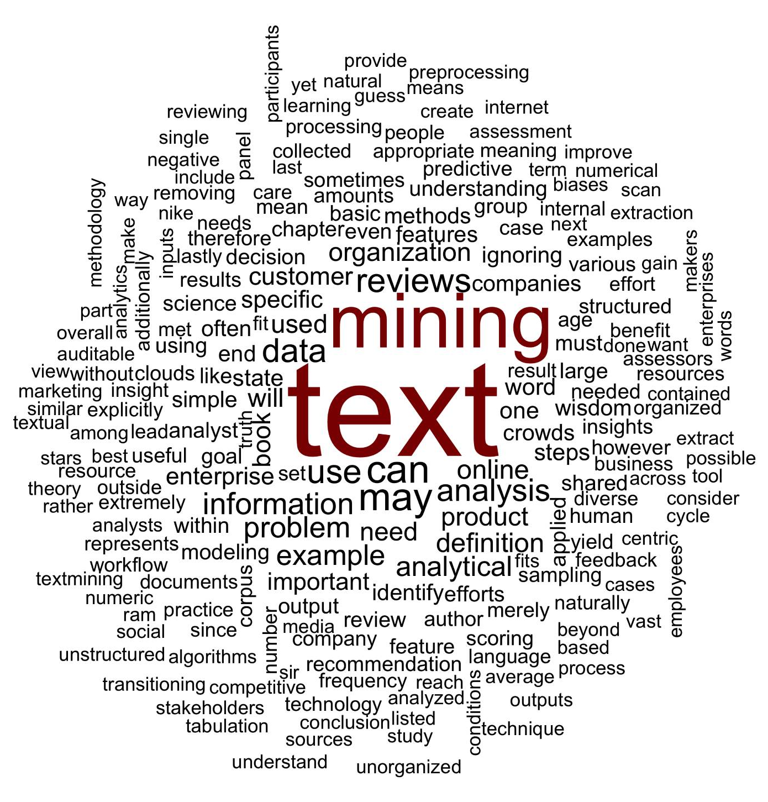
What is a word cloud?
Maligned and overused, a word cloud is a frequency visualization.

Slide 2
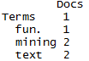
Unigram Tokenization
Thus far, we have performed unigram tokenization of terms.
“Text mining is so fun. So do text mining!
*with common stopwords

Slide 3
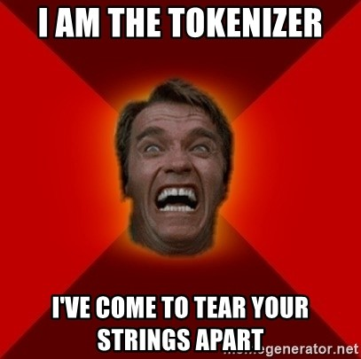
Changing Tokenization Schema
First create a function defining tokenization then add as a control parameter to TDM or DTM.
Within R
#bigram token maker
bigramTokens <-function(x)
unlist(lapply(NLP::ngrams(words(x), 2), paste, collapse = " "), use.names = FALSE)
wineTDM<-TermDocumentMatrix(txtCorpus, control=list(tokenize=bigramTokens))

Slide 4
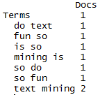
Tokenization is the process of chopping up a string into predefined units called tokens.
Now the TDM has two terms instead of one.
“Text mining is so fun. So do text mining!
#bigram token maker
bigramTokens <-function(x)
unlist(lapply(NLP::ngrams(words(x), 2), paste, collapse = " "), use.names = FALSE)
wineTDM<-TermDocumentMatrix(txtCorpus, control=list(tokenize=bigramTokens))

Slide 5
To make a wordcloud start with a WFM
# Get Row Sums & organize
wineTDMv <- sort(rowSums(wineTDMm), decreasing = TRUE)
wineDF <- data.frame(word = names(wineTDMv), freq = wineTDMv)
Term Document Matrix
Word Freq Matrix
 | Tweet1 | Tweet2 | Tweet3 | Tweet4 | … | Tweet_n
Term1 | 0 | 0 | 0 | 0 | 0 | 0
Term2 | 1 | 1 | 0 | 0 | 0 | 0
Term3 | 1 | 0 | 0 | 2 | 0 | 0
… | 0 | 0 | 3 | 0 | 1 | 1
Term_n | 0 | 0 | 0 | 1 | 1 | 0
word | freq
Term1 | 1
Term2 | 2
Term3 | 3
… | 5
Term_n | 2

Slide 6
Then sort it decreasing = TRUE
# Get Row Sums & organize
wineTDMv <- sort(rowSums(wineTDMm), decreasing = TRUE)
wineDF <- data.frame(word = names(wineTDMv), freq = wineTDMv)
word | freq
Term1 | 1
Term2 | 2
Term3 | 3
… | 5
Term_n | 2
word | freq
… | 5
Term3 | 3
Term2 | 2
Term_n | 2
Term1 | 1

Slide 7
Setting a pre-made color palette for your WC
# Review all Pallettes
display.brewer.all()
# Choose a color & drop light ones
pal <- brewer.pal(8, "Blues")
pal <- pal[-(1:2)]

Slide 8
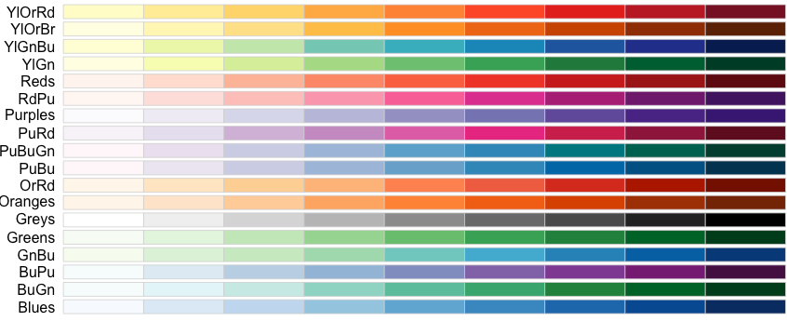
Setting a pre-made color palette for your WC
In R…

Slide 9
Let’s practice!
B_SimpleWordCloud.R

Slide 10
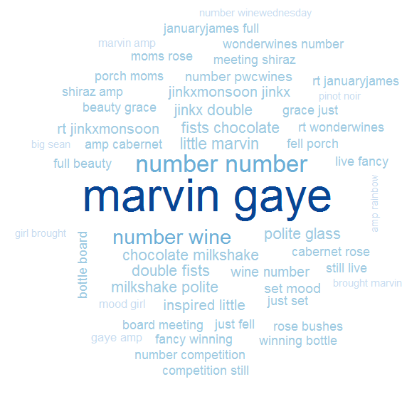
B_SimpleWordCloud.R
Bigram Tokenization has captured “marvin gaye”
A word cloud is a frequency visualization. The larger the term (or bigram here) the more frequent the term.
You may get warnings if certain tokens are to large to be plotted in the graphics device.
Be careful with your preprocessing steps!

Slide 11
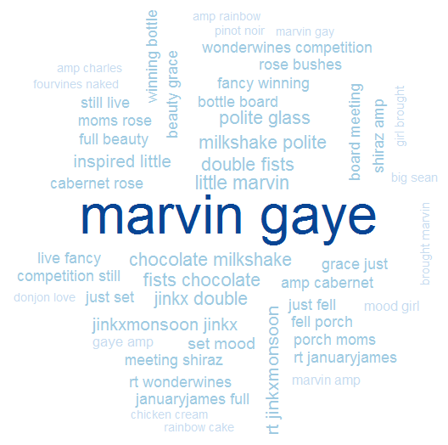
B_SimpleWordCloud.R
In cleanCorpus() the function replace_symbol() changes numeric with the generic string “number” so be careful with your preprocessing steps!

Slide 12
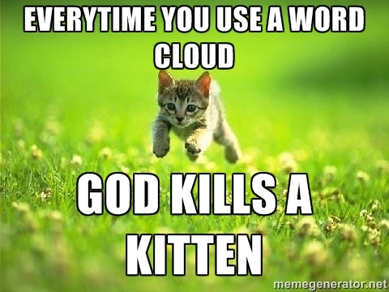
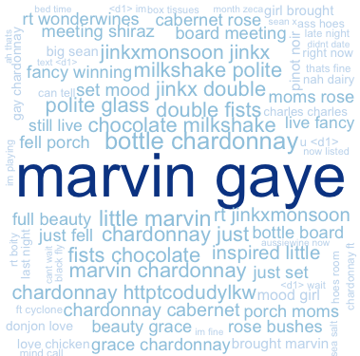
WCs are boring with a single corpus.
Single Corpus
wordcloud( )

Slide 13
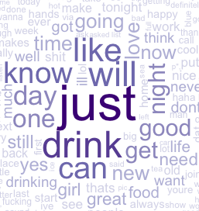
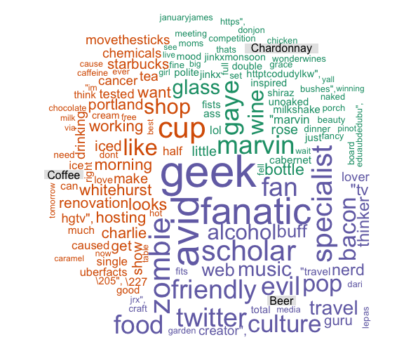
With 2+ Corpora, WCs are more insightful
Multiple Corpora
comparison.cloud( )
commonality.cloud( )
comparison.cloud( )
comparison.cloud( )

Slide 14
Dealing with many text files is tricky.
One Option
# Read in multiple files as individuals
txtFiles <- list.files(
path = '~/Desktop/Odum_Feb_23/lessons/Feb8/data',
pattern = 'chardonnay|coffee|beer',
full.names = T)
# Make a list of DFs
txtLst <- lapply(txtFiles, read.csv)
Using a loop each file is an individual object.
txtLst
chardonnay.csv
coffee.csv

Slide 15

Each list element is still a data frame
txtLst
chardonnay – 1000 Tweets
txtLst[[1]]$text
chardonnay.csv
txtLst[[1]]$doc_id
txtLst[[1]][,2]
coffee – 1000 Tweets
coffee.csv
txtLst[[2]]$text
txtLst[[2]]$doc_id
txtLst[[2]][,2]

Slide 16
Loop through each element and apply the processing steps
txtLst
i <- 1 the first time through…
Referring to the first list data frame..
Then 2 and so on
chardonnay.csv
for(i in 1:length(txtLst)){
print(paste('working on',i, 'of', length(txtLst)))
tmp <- paste(txtLst[[i]]$text, collapse = ' ')
tmp <- VCorpus(VectorSource(tmp))
tmp <- cleanCorpus(tmp, stops)
tmp <- sapply(tmp, content)
txtLst[[i]] <- tmp
}
coffee.csv

Slide 17
Manipulating multiple corpora
Combined/Collapsed
into a 2 document corpus
CorpusA – 1000 Tweets
Clean & Collapse
CorpusB – 1000 Tweets
Clean & Collapse
When you collapse, all the information for a subject is considered one document.

Slide 18
Manipulating multiple corpora
chardonnay – 1000 Tweets
Clean & Collapse
Everything known about Chardonnay
beer – 1000 Tweets
Clean & Collapse
Everything known about Beer
We now have 2 documents, not 2000. Document 1 is everything we know about chardonnay and document 2 is everything we know about beer.

Slide 19
The new WC will examine inner and disjoins
The collapses documents can be examined using set theory. “inner join”, “outer join”

Slide 20
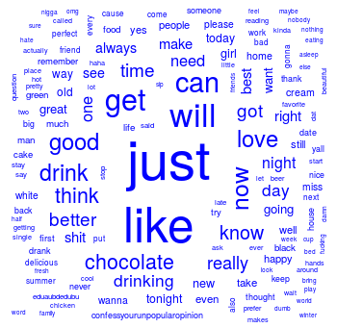
What tokens are in common?

Slide 21
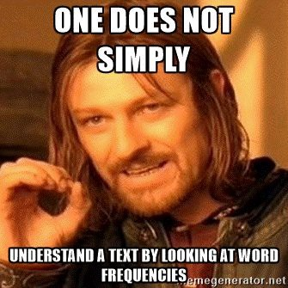
Lets make some improved word clouds
C_CommonalityCloud.R

Slide 22
Introducing TF-IDF Term Frequency Inverse Document Frequency
So far, you have used simple term frequency to identify informative words. Chardonnay is highly frequent in the tweets, but since it appears in all documents it isn’t informative.
Term frequency * inverse-document-frequency
If a term appears often, it must be important to the corpus.
But, if a term appear in many documents, it can’t be distinctive or informative
Increasing
importance
Offsetting
importance

Slide 23
The TF of TF-IDF
Term Frequency isn’t just a count. It is normalized because unique terms will naturally increase the longer the document.
Term frequency = Term Occurrence / total unique terms in a document

Slide 24
Inverse Document Frequency
IDF is the natural log of total documents divided by the number of documents containing a specific token.
Inverse Document Frequency =
log(total documents in corpus) / number of documents with term in it
Notes:
Pg 101 in book has explanation

Slide 25
Original Term Frequency
In 1000 documents suppose token “coffee” occurs 1000 times
TF = 1000

Slide 26
TF-IDF Simple Example
Coffee TF = 1000 will look VERY important but TFIDF = 0.69 will correctly have minimal impact for analysis.
In 1000 documents each of 10 words suppose token “coffee” occurs 1000 times
TF = 1000 / 10 #normalizes to doc length
TF = 100
IDF = log(1000) / 1000
IDF = 6.90 /1000
IDF = .0069
*Caveat – the results in R are normalized/scaled by default.
TF-IDF = 100 * .0069
TF-IDF = .69

Slide 27
Applying TF-IDF to a DTM/TDM
You can pass in more than one control parameter like tokenization & weighting.
# Control Paramter
ctrl <- list(weighting = weightTfIdf)
# Apply in TDM/DTM construction
drinkTDM <- TermDocumentMatrix(allDrinks, control = ctrl)
# Change to a simple matrix
drinkTDMm <- as.matrix(drinkTDM)

Slide 28
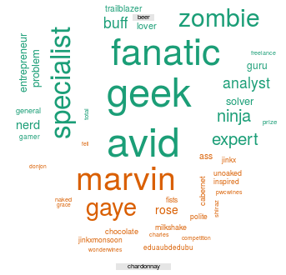
What tokens are in not in common (disjoint)?

Slide 29
What about disjoint tokens?
D_ComparisonCloud.R

Slide 30
What about proportional similarities?
The problem is that if corpusA has 1 instance & corpus has 1000 they appear as shared.

Slide 31
Let’s make some pyramids

Slide 32
Steps for a pyramid plot…collapse
Combined/Collapsed
into a 2 document corpus
CorpusA – 1000 Tweets
Clean & Collapse
CorpusB – 1000 Tweets
Clean & Collapse

Slide 33
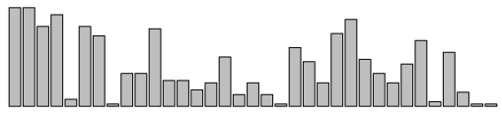
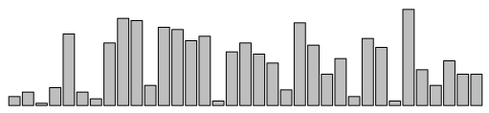
Steps for a pyramid plot…ID common tokens & frequency

Slide 34
Build a “pyramid plot” of frequencies
termA
termB
…
TermN

Slide 35

Open ﻿E_Pyramid_plots.R

